Slide 1

MINOR PROJECT:
COGNITIVE MUSIC RECOMMENDATION SYSTEM
UNDER THE GUIDENCE OF:
Mr. G Anil Kumar
(Associate Professor)
PRESENTED BY:
T. Chandradeep (21p61a0545)
B. Lakshmi Pranuthi (21p61a0526)
B. Sai Rushikesh Reddy(21p61a0538)

Slide 2

ABSTRACT:
The Cognitive Music Recommendation System leverages natural language processing to deliver personalized music suggestions. By analyzing user preferences, moods, and listening behavior, the system adapts dynamically to provide context-aware recommendations. It integrates sentiment analysis and keyword recognition to enhance the relevance of its suggestions. The system aims to bridge the gap between user needs and vast music libraries, offering seamless and intuitive recommendations.

Slide 3
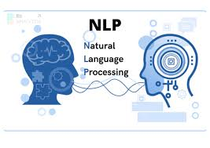
INTRODUCTION:
The Cognitive Music Recommendation System is a web-based application that offers personalized music recommendations based on user sentiment. Using Flask for the backend and BERT for sentiment analysis, the system interprets user input to determine emotional states like happiness, sadness, or excitement. It then matches these emotions to appropriate songs from a curated library. By analyzing sentiment scores and specific keywords, the system enhances its understanding of the user's mood. This dynamic and adaptive approach allows users to discover music that resonates with their emotional state, creating a tailored listening experience.

Slide 4
OBJECTIVES:
Implement Sentiment Analysis
Categorize Emotional States
Generate Music Recommendations
Integrate User Input
Ensure Dynamic Adaptation

Slide 5
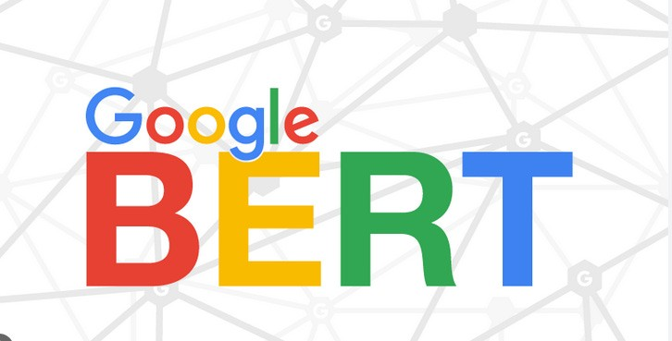
PROPOSED SYSTEM:
The proposed system is a web-based application that integrates sentiment analysis with personalized music recommendations. By leveraging BERT sentiment analysis, the system evaluates user text to determine emotional states such as happiness or sadness. Based on the identified mood, it provides curated song suggestions to enhance or match the user’s emotional state. The user-friendly interface allows for easy input and display of recommendations, creating a dynamic and engaging music discovery experience.

Slide 6
SOFTWARE & HARDWARE REQUIREMENTS:
RAM: 4GB
Hard Disk: 1GB of free Hard Disk space
Operating System: Compatible with Windows, macOS, and Linux operating systems.
Coding Language: Python
IDE: Visual Studio Code, Google Colab.

Slide 7
REFERENCES:
https://research.google/pubs/bert-pre-training-of-deep-bidirectional-transformers-for-language-understanding/
https://chatgpt.com/c/2a7dc767-15ef-4ffc-8caa-
https://www.koyeb.com/docs/deploy/flask

